Slide 1
SAT-Controlled Redundancy Addition and Removal ⎯ A Novel Circuit Restructuring Technique
Chi-An Wu, Ting-Hao Lin, Shao-Lun Huang, Chung-Yang (Ric) Huang
Graduate Institute of Electronics Engineering
National Taiwan University

Slide 2
Outline
Introduction
  Redundancy Addition and Removal (RAR) in a circuit
Previous RAR techniques
  RAMBO
  2-Way RAR
Proposed SAT-controlled RAR technique
  Single wire replacement
  Single gate replacement
  Sub-circuit replacement
  Implementation details
Experiments
  Sat-Controlled RAR vs. 2-Way RAR
  Different options in Sat-Controlled RAR
  Optimization filters for Sat-Controlled RAR
Conclusion

Slide 3
Redundancy in a Combinational Circuit
Definition
  A piece of wire, gate, or sub-circuit, when added to or removed from the circuit, does not change the circuit’s functionality
In circuit optimization,
  Removing redundancies can lead to an optimized circuit (area, timing, power, etc)
  Different sequences of redundancy removal usually lead to different optimization results
a
a
b
b

Slide 4
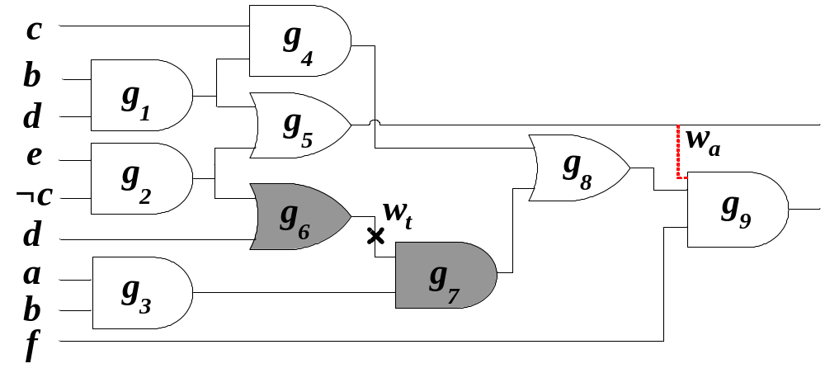
Redundancy Addition and Removal (RAR)
After (deliberately) adding a redundancy, some previously irredundant wires/gates may become redundant and thus removable
  After the redundant wire w_{a} is added, the previously irredundant wire w_{t} becomes redundant and thus removable
    Both g₆ and g₇ can be removed

Slide 5
Checking Redundancy in a Circuit
Redundancy in a combinational circuit
= Single stuck-at fault untestable
s-a-
1
PIs
POs

Slide 6
Necessary Testability Conditions
Test Patten Generation
(Fault sensitization) Assign the required value on the fault site
(Fault propagation) Assign the required values on the side inputs of the dominators
(Justification) Find an input assignment that satisfy the above requirements and propagate the fault effect to a PO
➔ If found, fault is testable
➔ If not found, fault is untestable
(Mandatory assignment, MA)
Perform logic implications for 1 & 2
NP Complete problem

Slide 7
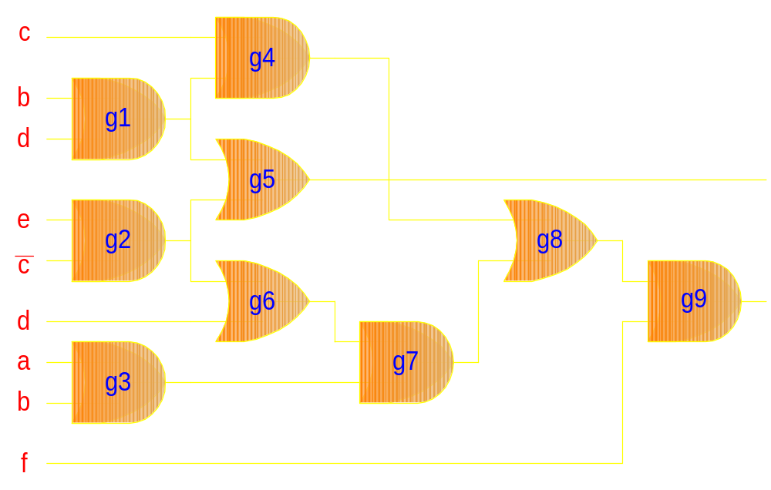
S-a-1 Fault Test on g6
0
Fault sensitization
Fault propagation
0
0
0
0/1
0
0
0/1
s-a-1
0
X
1
1
1
0/1
1
g6 is testable and thus NOT redundant

Slide 8
How to add an extra wire to make the s-a-1 fault @ g6 untestable?
0
0
1
0
0
0/1
0
1
0
1
0/1
0
0
s-a-1
0
X
1
1
1
0/1
1
Adding a wire (or with inverter) from any implied gate to a dominator

Slide 9
But remember,
the added wire must be redundant!!

Slide 10
Is (g1 ◦ g8) redundant?
0
0
1
0
X
s-a-0
0
0
1/0
0
1/0
0
0
0
1
No, (!g1 → g8) is NOT redundant

Slide 11
Is (g5  g9) redundant?
0
Conflict on its MA...
Yes, (g5 → g9) is redundant
0
0
1
0
X
s-a-1
0
1
1
1
1
1
0
1
We can remove g6 and then g7

Slide 12
RAMBO: Redundancy Addition and removal for Multi-level Boolean Optimization
[Cheng et.al. TCAD 1995]
Given a target wire, perform its mandatory assignments (MA) for its corresponding s-a fault
For each gate g_{m} in the set of MA,
  For each dominator g_{d}, test the fault on the added wire (g_{m} → g_{d})
    If value(g_{m}) = 0 and g_{d} is an AND ➔ direct connection
    If value(g_{m}) = 1 and g_{d} is an AND ➔ add an inverter
    If value(g_{m}) = 0 and g_{d} is an OR ➔ add an inverter
    If value(g_{m}) = 1 and g_{d} is an OR ➔ direct connection
If the fault on the added wire in 2.a ~ 2.d is untestable,
➔ the added wire is redundant and can be an alternative wire to remove the target wire

Slide 13
RAMBO Algorithm Complexity
Need to perform (M * D) redundancy tests
  M: number of gates in MA
  D: number of dominators
  ➔ Could be a BIG number
“Perturb and Simplify” (Chang, et. al. TCAD 1996)
  Propose several rules to filter out impossible candidates
  ➔ Still quite time-consuming

Slide 14
How do we add “something” to a circuit and guarantee it is redundant?
e.g. Add to the input of an AND gate g_{d}
  Test the output s-a-0 fault of this AND gate
  Perform MA of this fault
  For each gate g_{s} in the MA, there is a corresponding redundant wire (or with inverter) to g_{d}
1
s-a-0
1
g_{d}
X
1
1
g_{s}
Why??

Slide 15
Adding a redundant wire to g₉
1
1
redundant wire
1
1
1
X
s-a-0
1
1
Try MA of g_{d} : g9 s-a-0

Slide 16
Remember:
(g5  g9) can make (g6  g7) redundant
0
0
0
0
0/1
0
0
0
0
s-a-1
0
X
1
1
1
0/1
1
Adding a wire (or with inverter) from any implied gate to a dominator

Slide 17
2-Way RAR Algorithm [Entrena 2006]
Given a target wire on w_{t}, perform MA(w_{t})
Given a destination gate g_{d}(dominator of the target wire w_{t}), perform MA(g_{d})
Perform an intersection of (1) and (2)
Any inverse value on a gate g_{s} implies an alternative wire (g_{s}  g_{d}) or (g_{s} ◦ g_{d}) for the target wire w_{t}
g_{t}
W_{t} s-a-1
g_{t}
g_{d}s-a-0
X
1
1
g_{d}
1
g_{d}
X
1
1
g_{s}
0
g_{s}
1

Slide 18
2-Way RAR Algorithm
Pros
  No need to perform (M*D) redundancy tests as in original RAMBO
  ➔ Only 2*D tests are needed
Cons
  MA(w_{t}) may NOT intersect with MA(g_{d})
    Or just find some trivial alternative wires (e.g. DeMorgan Law)
  Methods to derive more MAs(e.g. Recursive learning) are often very expensive

Slide 19
Adding a redundant wire to g₉
level-2 recursive learning
g₉,1
g₈,1
g₆,1
g₅,1
f,1
b,1
1
level-1 recursive learning
1
1
redundant wire
1
1
X
s-a-0
1
1

Slide 20
SAT-Controlled RAR (SatRAR)
Problems with previous RAR techniques
  RAMBO: too many redundancy tests
  2-Way RAR: expensive implication technique needed
SAT-controlled RAR
  NOT just take the advantage of the advancements from the modern SAT solvers
    Efficient BCP, conflict-driven learning, etc
  A seamless integration of SAT and RAR algorithms
  Extensions for general RAR
    Alternative wire, gate, sub-circuit identification
  Options to “control” the RAR optimization quality

Slide 21
Single Wire Replacement Theorem in SatRAR
Let MA(w_{t}) and MA(g_{d}) be the mandatory assignments for the fault tests of the target wire w_{t} and its dominator g_{d}, respectively.
Let <g_{s}, v> belong to MA(w_{t}) but not MA(g_{d}), and g_{s} be not in the fanout cone of g_{d}.
If we make a decision <g_{s}, v> on top of MA(g_{d}) and encounter a conflict, then
  (i) MA(g_{d}) ⇒ <g_{s}, ¬v>
  (ii) (g_{s} g_{d}) or (g_{s}◦ g_{d}) must be a valid alternative wire for w_{t}

Slide 22
Single Wire Replacement in SatRAR
MA(w_{t} = g₆) =
{ (g6, 0), (g2, 0), (d, 0), (g1, 0),
(g4, 0), (g5, 0), (g3, 1), (a, 1),
(b, 1), (f, 1) }
0
1
0
1
decision
valid alternative wire
0
0
1
1
1
w_{t}
X
s-a-0
1
1
1
1
1
1

Slide 23
Single Wire Replacement in SatRAR
MA(w_{t})
a
MA(g_{d})
conflict
a
MA(w_{t}) → a
MA(g_{d}) → ¬ a
w_{t}
g_{d}
a

Slide 24
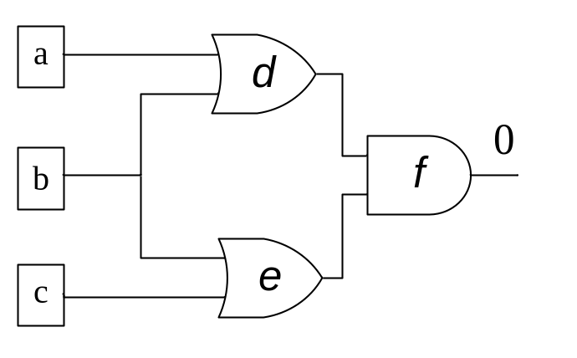
SRAR-Wire vs. 2-Way RAR
Similarity
  Based on the conflicting implications between MA(w_{t}) and MA(g_{d})
Difference
  SAT decision (conflict-driven leanring) vs. Recursive learning
Recursive learning:
f = 0 ⇒ d = 0 or e = 0
⇒ { a=0, b=0 } or { b=0, c=0 }
⇒ b = 0 (Cannot be recorded)
Conflict-driven learning:
f = 0; decision b = 1 results in conflict
➔ f = 0 ⇒ b = 0 (Recorded!!)

Slide 25
SRAR-Wire vs. Original RAMBO
Similarity (looks like...)
  For each assignment g_{s} in { MA(w_{t}) - MA(g_{d}) }... vs.
  For each assignment g_{s} in MA(w_{t})...
Difference
  Incremental SAT vs. Independent redundancy tests
Incremental SAT in SatRAR
  MA(g_{s}) is performed on top of MA(g_{d})
    Sharing of different MA(g_{di})
  Conflict-driven learning
    Learning & RAR at the same time
  Implication filter
    Reduce #decisions
  More importantly, can be extended for alternative gate/sub-circuit replacements

Slide 26
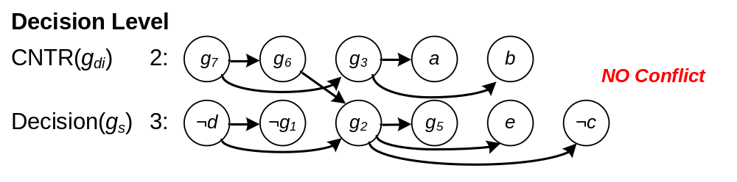
Implication Filter
If the decision (d, 0) does not lead to a conflict
➔ Any of its new implication (e.g. (g₁, 0))
cannot lead to a conflict
➔ Can be removed from the decision candidate list

Slide 27
Single Gate Replacement Theorem in SatRAR
Let MA(w_{t}) and MA(g_{d}) be the mandatory assignments for the fault tests of the target wire wt and its dominator gd, respectively.
Let both <g_{s}, u> and <g_{t}, v> belong to MA(w_{t}), and be not in the fanout cone of gd.
Suppose we make the decision <g_{s}, u> after MA(g_{d}) and result in an implication <g_{t}, ¬v>.
Let a gate g_{n} = AND(<g_{s}, u>, <g_{t}, v>). Then
  (i) MA(g_{d}) ⇒ ¬ g_{n},
  (ii) g_{n} or ¬ g_{n}, when connected to g_{d}, must be a valid alternative gate for w_{t}

Slide 28
Single Gate Replacement in SatRAR
* MA(g6) = { (g6, 0), (g2, 0), (d, 0), (g1, 0), (g4, 0), (g3, 1), (a, 1), (b, 1), (f, 1) }
MA(g6) → (g1, 0) ∧ (g2, 0)
c
g4
0
MA(g₉=1)
1
g₂ = 1
b
g1
0
g₁ = 0
0
decision
d
MA(g9) → (g1, 1) ∨ (g2, 1)
e
g2
1
g_{d} s-a-0
0
¬c
g9
g8
1
1
o2
1
w_{t}
d
0
g6
1
g7
1
a
g3
1
1
b
f
1

Slide 29
Single Gate Replacement in SatRAR
MA(g6) → (g1, 0) ∧ (g2, 0)
c
g4
0
Let g_{n} = ¬ ((g1, 0) ∧ (g2, 0))
= (g1, 1) ∨ (g2, 1)
1
b
g1
0
0
d
MA(g9) → (g1, 1) ∨ (g2, 1)
g_{n}
e
g2
1
alternative gate
g_{d}
0
¬c
g9
g8
1
1
o2
1
w_{t}
d
0
g6
1
g7
1
a
g3
1
1
b
f
1

Slide 30
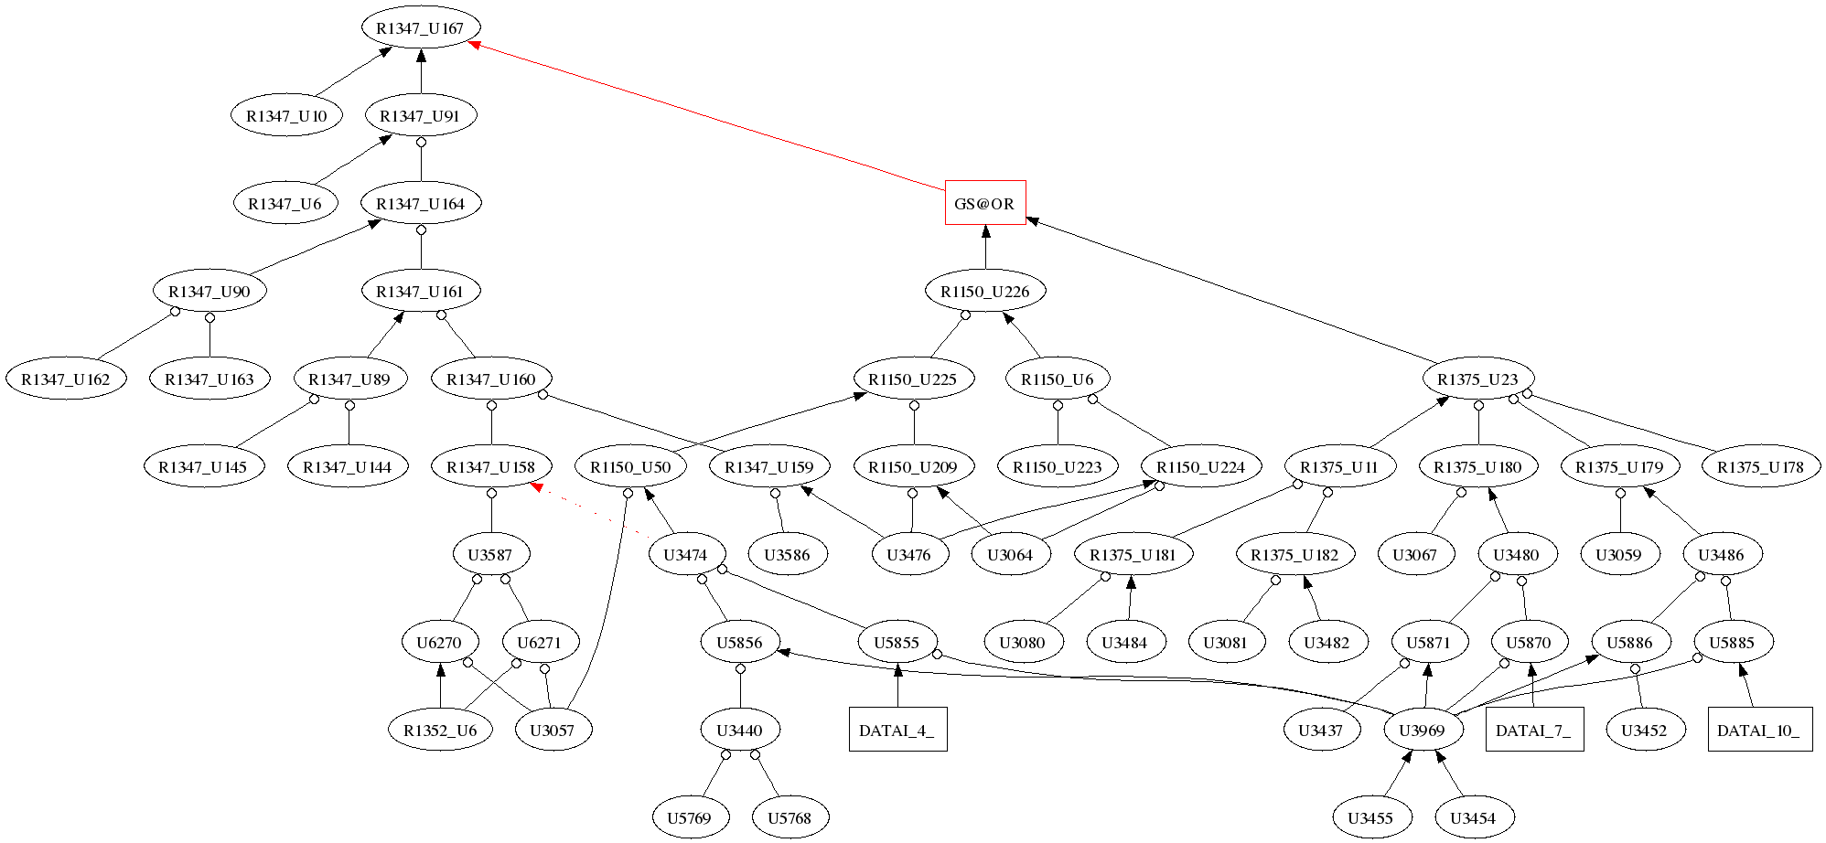
Single Gate Replacement Example
alternative gate (OR gate)
AND gate
PI gate
inverted input
target wire
Testcase: B14

Slide 31
Implementation Details
Multiple-input alternative gates
  The more decisions, the more
  inputs for alternative gates
Multiple alternative wires/gates identification
  By checking the implication graphs of MA(w_{t}) and MA(g_{d})
  One decision ➔ multiple alternative wires/gates
Optimization score filters
  Control the quality of generated alternative logic
  Decisions made on gates with higher optimization power
Duplicated alternative wire/gate removal
  Implemented in functionally reduced And-Inverted Graph (AIG)
Verified by equivalence checker
n-1 decisions
inverse imp

Slide 32
Alternative Sub-circuit by SatRAR
MA(w_{t})
a
MA(g_{d})
¬b
¬b
c
a
¬c
MA(w_{t}) → a ∧ (b ∨ c)
MA(g_{d}) → ¬ (a ∧ (b ∨ c))
w_{t}
g_{d}
a
b
c

Slide 33
SAT-Controlled RAR vs. 2-Way RAR L0
 |  | SRAR_Wire |  |  | 2WRAR_L0
Cir. | #wires | #tar | #alt | #T | #tar | #alt | #T
C432 | 336 | 129 | 211 | 0.03 | 55 | 91 | 0.02
C499 | 408 | 40 | 40 | 0.03 | 40 | 40 | 0.03
C3540 | 2939 | 1272 | 3639 | 1.14 | 1195 | 3094 | 0.31
C6288 | 4800 | 1011 | 1043 | 0.18 | 100 | 116 | 0.16
C7552 | 6144 | 2291 | 7694 | 0.94 | 2063 | 6296 | 0.37
b01 | 80 | 12 | 19 | 0.01 | 4 | 4 | 0.01
b13 | 558 | 141 | 271 | 0.05 | 72 | 92 | 0.03
b14 | 1.9e4 | 9702 | 1.5e5 | 32.9 | 9238 | 1.3e5 | 6.91
b15 | 1.7e4 | 5253 | 2.0e4 | 56.3 | 4055 | 1.2e4 | 7.94
b17 | 6.2e4 | 2.3e4 | 1.0e5 | 289 | 1.9e4 | 6.8e4 | 37.0
b18 | 2.2e5 | 9.7e4 | 8.7e5 | 1353 | 8.6e4 | 6.8e5 | 199
b19 | 4.3e5 | 2.0e5 | 1.5e6 | 2970 | 1.7e5 | 1.1e6 | 473
Ratio | 3.79 | 1 | 1 | 1 | 0.71 | 0.62 | 0.43

Slide 34
SAT-Controlled RAR vs. 2-Way RAR L1
 |  | SRAR_Wire |  |  | 2WRAR_L1
Cir. | #wires | #tar | #alt | #T | #tar | #alt | #T
C432 | 336 | 129 | 211 | 0.03 | 80 | 139 | 0.10
C499 | 408 | 40 | 40 | 0.03 | 40 | 40 | 0.32
C3540 | 2939 | 1272 | 3639 | 1.14 | 1236 | 3537 | 6.94
C6288 | 4800 | 1011 | 1043 | 0.18 | 1011 | 1043 | 0.57
C7552 | 6144 | 2291 | 7694 | 0.94 | 2257 | 7685 | 5.40
b01 | 80 | 12 | 19 | 0.01 | 12 | 17 | 0.02
b13 | 558 | 141 | 271 | 0.05 | 133 | 226 | 0.12
b14 | 1.9e4 | 9702 | 1.5e5 | 32.9 | 9835 | 1.4e5 | 376
b15 | 1.7e4 | 5253 | 2.0e4 | 56.3 | 5054 | 2.0e4 | 1309
b17 | 6.2e4 | 2.3e4 | 1.0e5 | 289 | 2.2e4 | 1.0e5 | 4454
b18 | 2.2e5 | 9.7e4 | 8.7e5 | 1353 | 9.6e5 | 8.5e6 | 1.4e4
b19 | 4.3e5 | 2.0e5 | 1.5e6 | 2970 | -- | -- | >2.4e4
Ratio | 3.79 | 1 | 1 | 1 | 0.95 | 0.94 | 8.52

Slide 35
SAT-Controlled RAR vs. 2-Way RAR L2
 |  | SRAR_Wire |  |  | 2WRAR_L2
Cir. | #wires | #tar | #alt | #T | #tar | #alt | #T
C432 | 336 | 129 | 211 | 0.03 | 105 | 168 | 1.80
C499 | 408 | 40 | 40 | 0.03 | 40 | 40 | 10.3
C3540 | 2939 | 1272 | 3639 | 1.14 | 1278 | 3853 | 360
C6288 | 4800 | 1011 | 1043 | 0.18 | 1011 | 1043 | 9.55
C7552 | 6144 | 2291 | 7694 | 0.94 | 2272 | 7921 | 359
b01 | 80 | 12 | 19 | 0.01 | 12 | 17 | 0.18
b13 | 558 | 141 | 271 | 0.05 | 143 | 259 | 1.17
b14 | 1.9e4 | 9702 | 1.5e5 | 32.9 | -- | -- | >2.4e4
b15 | 1.7e4 | 5253 | 2.0e4 | 56.3 | -- | -- | --
b17 | 6.2e4 | 2.3e4 | 1.0e5 | 289 | -- | -- | --
b18 | 2.2e5 | 9.7e4 | 8.7e5 | 1353 | -- | -- | --
b19 | 4.3e5 | 2.0e5 | 1.5e6 | 2970 | -- | -- | --
Ratio | 3.79 | 1 | 1 | 1 | 0.97 | 0.96 | 166

Slide 36
SRAR_Wire vs. SRAR_Gate
 |  | SRAR_Wire |  |  | SRAR_Gate
Cir. | #wires | #tar | #alt | Time | #tar | #alt | Time
C432 | 336 | 129 | 211 | 0.03 | 185 | 783 | 0.04
C499 | 408 | 40 | 40 | 0.03 | 64 | 136 | 0.04
C3540 | 2939 | 1272 | 3639 | 1.14 | 2080 | 2.6e4 | 1.62
C6288 | 4800 | 1011 | 1043 | 0.18 | 1922 | 1.1e4 | 0.40
C7552 | 6144 | 2291 | 7694 | 0.94 | 3849 | 5.3e4 | 1.94
b01 | 80 | 12 | 19 | 0.01 | 47 | 329 | 0.02
b13 | 558 | 141 | 271 | 0.05 | 355 | 3096 | 0.10
b14 | 1.9e4 | 9702 | 1.5e5 | 32.9 | 1.4e4 | 5.9e5 | 44.1
b15 | 1.7e4 | 5253 | 2.0e4 | 56.3 | 1.2e5 | 3.9e5 | 65.8
b17 | 6.2e4 | 2.3e4 | 1.0e5 | 289 | 4.5e4 | 3.0e6 | 353
b18 | 2.2e5 | 9.7e4 | 8.7e5 | 1353 | 1.6e5 | 1.6e7 | 1835
b19 | 4.3e5 | 2.0e5 | 1.5e6 | 2970 | 3.2e5 | 3.1e7 | 4000
Ratio | 3.79 | 1 | 1 | 1 | 1.98 | 12.68 | 1.51

Slide 37
Implication Filters & Conflict Learning
 |  | SRAR_Gate |  |  | SRAR_Gate-Lrn |  |  | SRAR_Gate-Imp
Cir. | #wires | #tar | #alt | Time | #tar | #alt | Time | #tar | #alt | Time
C432 | 336 | 185 | 783 | 0.04 | 184 | 701 | 0.04 | 185 | 819 | 0.05
C499 | 408 | 64 | 136 | 0.04 | 64 | 136 | 0.04 | 64 | 136 | 0.05
C3540 | 2939 | 2080 | 2.6e4 | 1.62 | 2079 | 2.3e4 | 1.54 | 2080 | 3.2e4 | 3.95
C6288 | 4800 | 1922 | 1.1e4 | 0.40 | 1922 | 9012 | 0.33 | 1922 | 1.1e4 | 0.43
C7552 | 6144 | 3849 | 5.3e4 | 1.94 | 3849 | 5.1e4 | 1.81 | 3849 | 6.3e4 | 2.67
b01 | 80 | 47 | 329 | 0.02 | 47 | 343 | 0.04 | 47 | 351 | 0.02
b13 | 558 | 355 | 3096 | 0.10 | 353 | 3045 | 0.11 | 355 | 3347 | 0.14
b14 | 1.9e4 | 1.4e4 | 5.9e5 | 44.1 | 1.4e4 | 5.2e5 | 40.9 | 1.4e4 | 9.4e5 | 130.5
b15 | 1.7e4 | 1.2e5 | 3.9e5 | 65.8 | 1.3e4 | 2.9e5 | 57.4 | 1.2e4 | 6.0e5 | 329.5
b17 | 6.2e4 | 4.5e4 | 3.0e6 | 353 | 4.5e4 | 2.1e6 | 327 | 4.5e4 | 4.2e6 | 1973
b18 | 2.2e5 | 1.6e5 | 1.6e7 | 1835 | 1.6e5 | 1.1e7 | 1580 | 1.6e5 | 2.1e7 | 9102
b19 | 4.3e5 | 3.2e5 | 3.1e7 | 4000 | 3.2e5 | 2.2e7 | 3402 | 3.2e5 | 4.3e7 | 2.0e4
Ratio | 3.79 | 1.98 | 12.68 | 1.51 | 1.97 | 10.34 | 1.37 | 1.98 | 16.30 | 3.86

Slide 38
Trivial vs. Non-trivial Alternative Logic
 | SRAR_Wire |  |  | SRAR_Gate |  |  | 2WRAR_L1
Cir | #total | #trivial | #non-triv | #total | #trivial | #non-triv | #total | #trivial | #non-triv
C432 | 211 | 63 | 148 | 783 | 484 | 299 | 139 | 53 | 86
C499 | 40 | 40 | 0 | 136 | 128 | 8 | 40 | 40 | 0
C3540 | 3639 | 420 | 3219 | 25805 | 8822 | 16983 | 3537 | 397 | 3140
C6288 | 1043 | 959 | 84 | 11026 | 10875 | 151 | 1043 | 959 | 84
C7552 | 7694 | 692 | 7002 | 53786 | 26661 | 27125 | 7685 | 643 | 7042
b01 | 19 | 9 | 10 | 329 | 248 | 81 | 17 | 7 | 10
b13 | 271 | 66 | 205 | 3096 | 2069 | 1027 | 226 | 50 | 176
b14 | 1.48e5 | 2987 | 1.45e5 | 5.86e5 | 1.74e5 | 4.12e5 | 1.47e5 | 2864 | 1.44e5
b15 | 19541 | 3652 | 15889 | 391591 | 212263 | 179328 | 19704 | 3269 | 16435
b17 | 1.03e5 | 12390 | 91040 | 3.01e6 | 1.17e6 | 1.84e6 | 1.03e5 | 10551 | 92887
b18 | 8.73e5 | 39743 | 8.33e5 | 1.58e7 | 5.30e6 | 1.05e7 | 8.53e5 | 32287 | 8.21e5
Ratio | 1 | 1 | 1 | 11.97 | 44.10 | 7.30 | 0.94 | 0.89 | 0.95

Slide 39
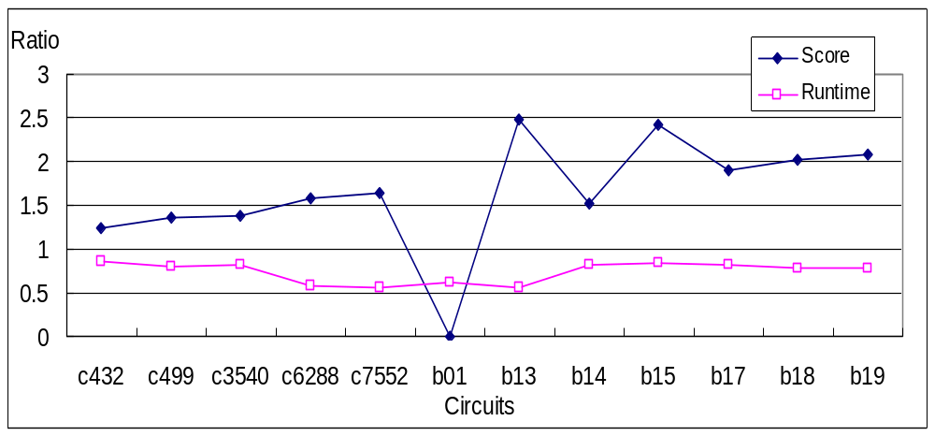
Optimization Filter
Decisions only on level difference > 5
Ave score improved ~80%
Runtime reduced by 26%

Slide 40
Conclusion
We are NOT just porting the recent advances in SAT into RAR engines
  Efficient Boolean constraint propagation (BCP) by watch scheme
  Conflict-driven learning with non-chronological backtracking
  ➔ We are not using SAT engine as a black-box
We tightly integrate the RAR algorithms into the (circuit-based) SAT engine
  Replacing testability checking on candidate alternative logic as SAT decisions
  Using incremental SAT so that the efforts on different alternative logic generations can be shared
  Implementing a unified RAR engine that can identify single-wire, single-gate, and even general sub-circuit alternative logic

Slide 41
Conclusion
For alternative wire identification
  Our algorithm can identify slightly more alternative wires than 2-Way RAR with recursive learning.
  However, our approach is much faster and can be applied to larger circuits
For alternative gate identification
  Our algorithm can generate ~12x more alternative gates than alternative wires with only ~50% overhead in runtime
Extended to general alternative sub-circuits
  Used for hard-to-replace target wires
  Served as general logic rewriting techniques

Slide 42
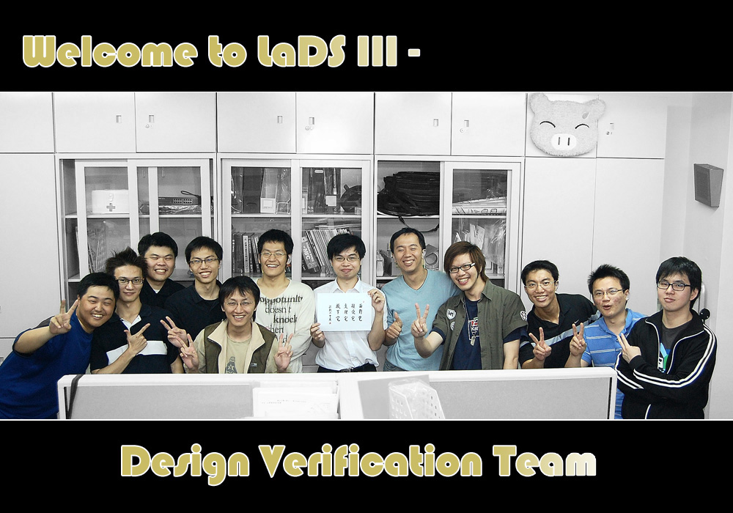
Questions?
Design Verification Lab @ National Taiwan University
  http://dvlab.ee.ntu.edu.tw

